Slide 1
ECOBINS in SMART CITIES
Kumkum Yadav, Garima Garg

Slide 2
OBJECTIVE
Waste or garbage in today’s world is produced in large quantities.
According to Los Angles Times, each year, nations generate 1.3 billion tons of waste.
This value is expected to soar to 4 billion tons by 2100.

Slide 3
We need not go so far……
Look around you. The garbage can outside your apartment.
Doesn’t it on some days overflow. How unhygienic is that!
But what if there was some IOT device that could help us to clear all this waste without wasting :
Fuel
Time
Human Labor of checking each can.

Slide 4
IDEA PROPOSAL
Ecobins, the idea that we are proposing does just that.
Sensors would be fitted in the garbage can to check the level of garbage.
Each garbage can will be provided with an unique code which would uniquely define it.
As soon as the garbage content reaches a specific limit in the garbage can, a warning would be issued at the garbage collection department.
The garbage collection department then can come collect the garbage from the full garbage can.

Slide 5
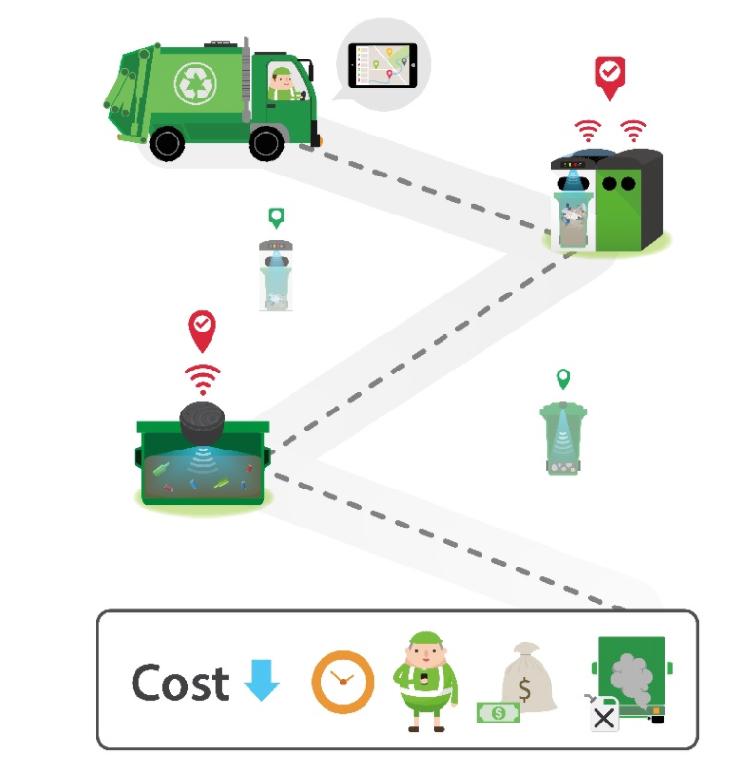
DIAGRAM

Slide 6
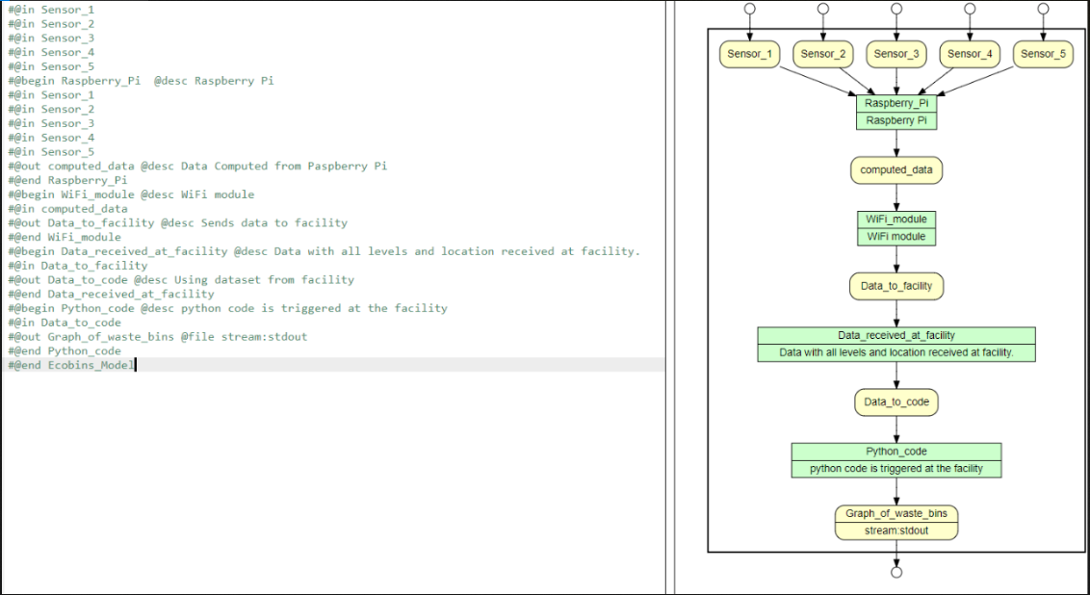
YESWORKFLOW

Slide 7
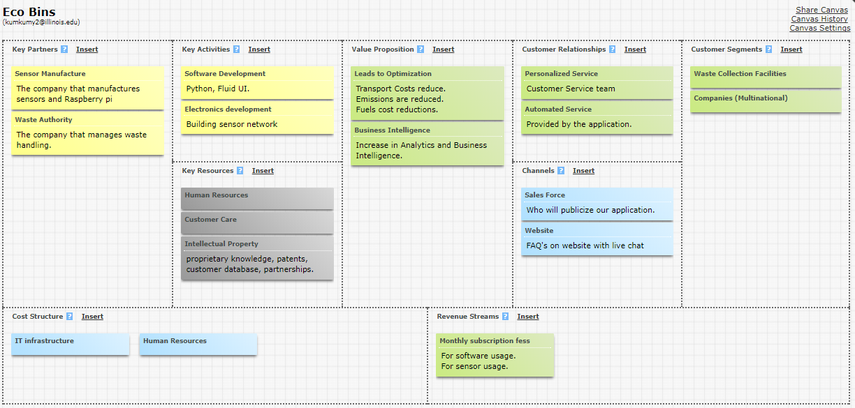
BUSINESS MODEL CANVAS
Business Model Canvas Link :https://canvanizer.com/canvas/wy2injkxn5GK3

Slide 8
SENSORS AND OTHER COMPONENTS
IR sensors
Raspberry Pi
WiFi module
Google APIs like
Google Maps Direction APIs
Google Maps Directions Matrix API
Google Maps Geocoding API
Google Maps JavaScript API
Google Places API Web Service

Slide 9
DATA PRIVACY
Transparency :
Users can check immediate reward points update on throwing the trash.
Policies related to business ethics , the environment and other public policy commitments will be disclosed.
Consent from end users before sharing the personal details will be taken.
Customers will be informed about revised user terms of service.
Control:
Nondisclosure agreement stating this personal data will not be shared unless wanted by the user (can be used to reduce tax or can be used as a coupon on government websites/shops).
Login credentials specific to the user which will be password protected.
The end users would have the absolute control over the data and they can view it whenever needed.

Slide 10
DATA PRIVACY
Trust:
The data collected from the garbage is accurate and is not biased.
Set Privacy and Security Rule, sets rules for how patient’s health and insurance providers information must be kept secured with administrative, technical, and physical safeguards.
User information protection with passwords, encryption, and other technical safeguards.
Value :
This data can help citizens to pay less tax and reduce governments resources and improve segregation of the trash(saving time and money).

Slide 11
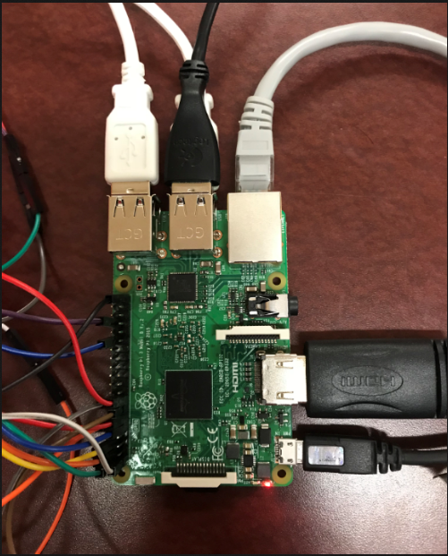
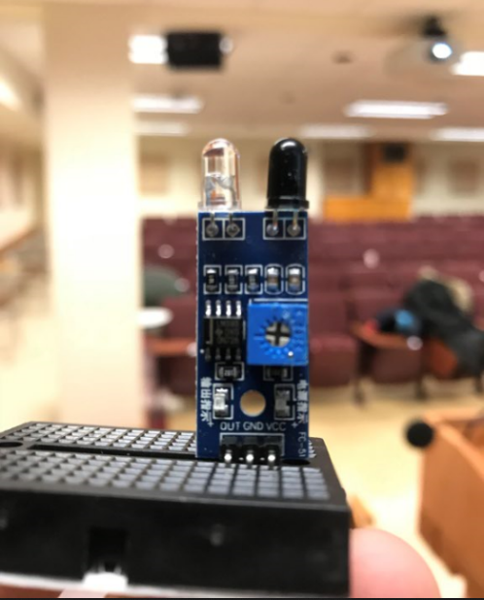
COMPONENTS USED

Slide 12
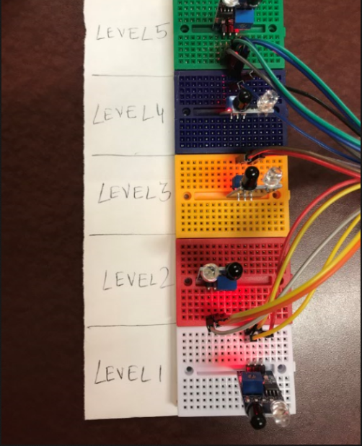
HOW DOES CIRCUIT LOOKS

Slide 13
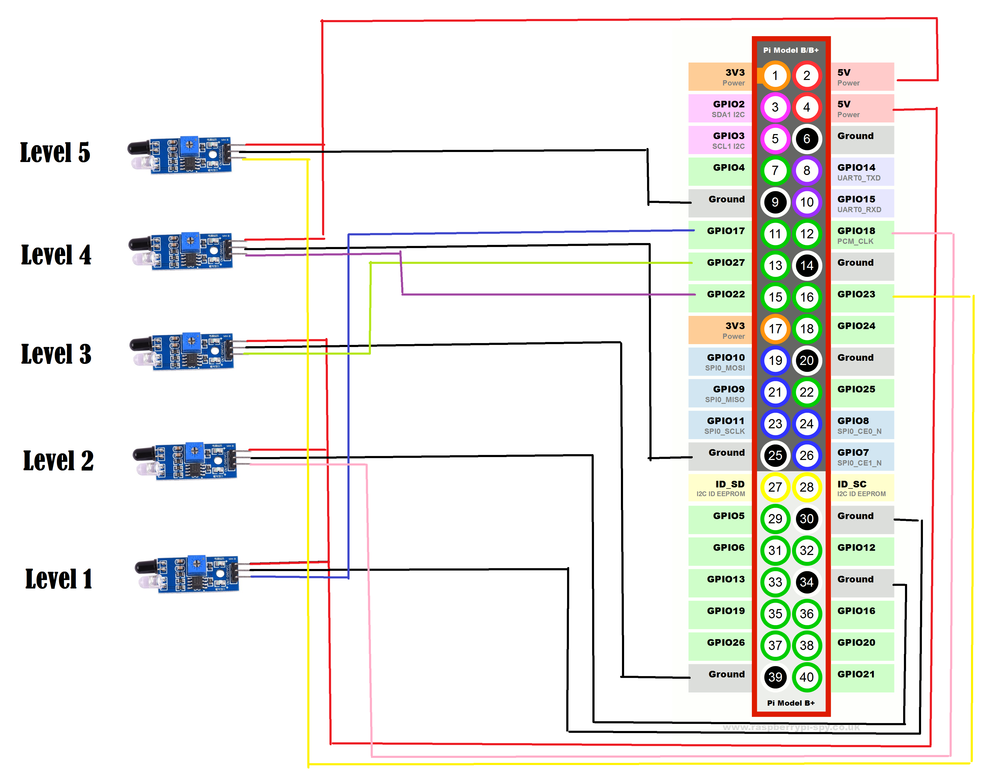
CIRCUIT DIAGRAM

Slide 14
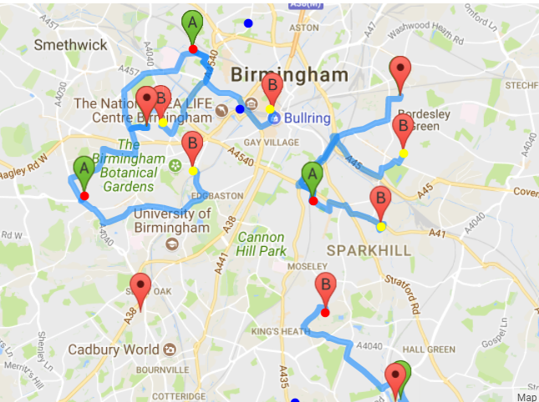
FINAL GRAPH

Slide 15
USE CASES
All garbage cans would be projected on the maps. The places where garbage cans are full or need immediate attention can be marked with red.
The places with middle full will be projected as yellow on the map.
And the least full garbage with blue dots.
The path would be made for garbage can with immediate or medium attention.

Slide 16
FUTURE SCOPE
Separation of garbage on the basis of them being renewable or non renewable is very important.
In this scope, such smart intelligence could be added in the cans, with which they could detect the item being thrown in either the recyclable section or the non recyclable section.
Smart citizen point would be awarded to these people which could be redeemed for some items.
This provides people with the incentive to keep their city clean.

Slide 17
MORE IDEAS…
Also, one could add solar panels on the garbage cans.
This could be then used to power the WiFi module and also store some power for night use.
Hence the bins, become their own WiFi hotspot without non renewable energy consumption.

Slide 18
BENEFITS
Reduced fuel consumption.
Labor can be reduced.
Time can be saved in checking bins everyday at everyplace.
Health is promoted as the city is clean and garbage is picked up right on time!

Slide 19
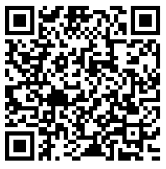
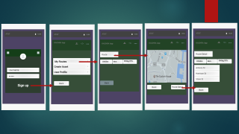
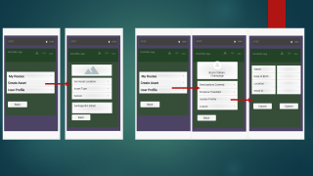
KACHRA APP
Either scan the QR Code or click on the QR Code to access the Kachra Application.

Slide 20
THANK YOU! ☺

Slide 21
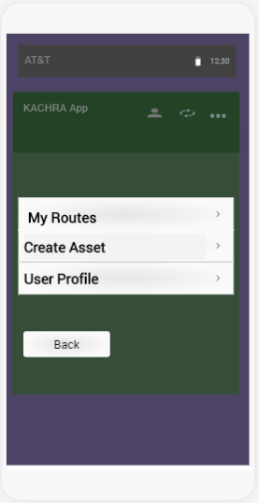
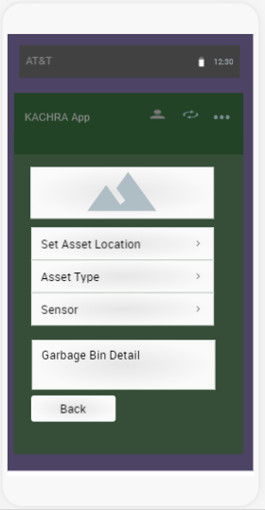
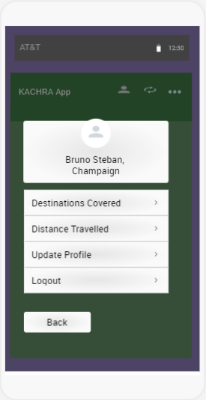
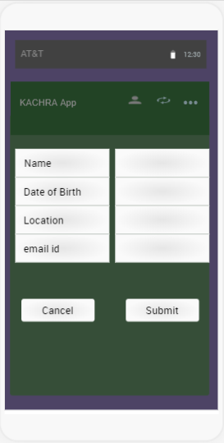

Slide 22
